Slide 1
What is Cluster Analysis?
Cluster: a collection of data objects
  Similar to one another within the same cluster
  Dissimilar to the objects in other clusters
Cluster analysis
  Grouping a set of data objects into clusters
Clustering is unsupervised classification: no predefined classes
Typical applications
  As a stand-alone tool to get insight into data distribution
  As a preprocessing step for other algorithms

Slide 2
Examples of Clustering Applications
Marketing: Help marketers discover distinct groups in their customer bases to develop targeted marketing programs
Land use: Identification of areas of similar land use in an earth observation database
Insurance: Identifying groups of insurance policy holders with a high average claim cost
City-planning: Identifying groups of houses according to their house type, value, and location
Earth-quake studies: Observed earth quake epicenters clustered along continent faults

Slide 3
What Is Good Clustering?
A good clustering method will produce high quality clusters with
  high intra-class similarity
  low inter-class similarity
The quality of a clustering result depends on both the similarity measure used by the method and its implementation.
The quality of a clustering method is measured by its ability to discover the hidden patterns.

Slide 4
Requirements of Clustering in Data Mining
Scalability
Deal with different types of attributes
Discovery of clusters with arbitrary shape
Requirements for domain knowledge to determine input parameters
Deal with noise and outliers
Insensitive to order of input records
High dimensionality
Incorporation of user-specified constraints
Interpretability and usability

Slide 5
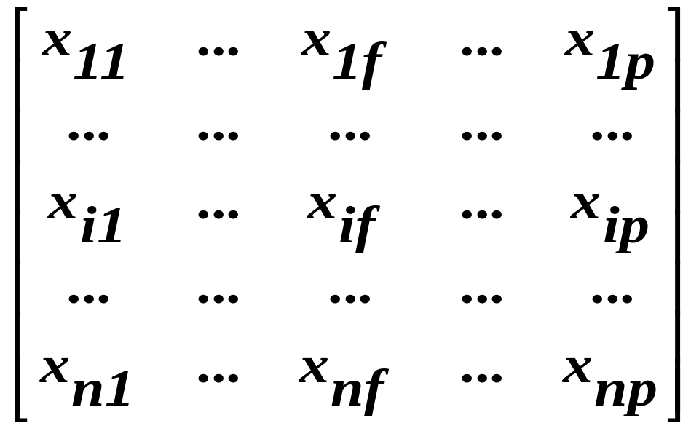

Data Structures
Data matrix
  (two modes)
Dissimilarity matrix
  (one mode)

Slide 6
Measure the Quality of Clustering
Dissimilarity/Similarity metric: Similarity is expressed in terms of a distance function, which is typically metric: d(i, j)
“Quality” function that measures the “goodness” of a cluster.
The definitions of distance functions are different for interval-scaled, boolean, categorical, ordinal and ratio variables.
Weights associated with different variables based on applications and data semantics.
It is hard to define “similar enough” or “good enough”

Slide 7
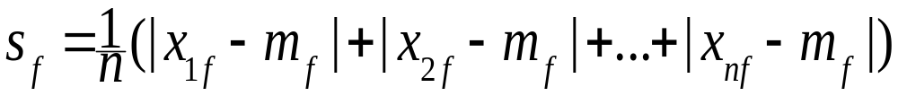
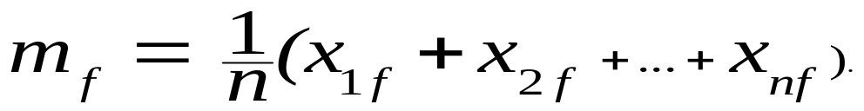
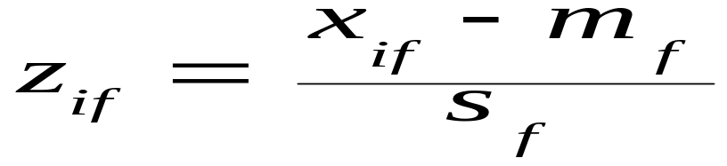
Interval-valued variables
Standardize data
  Calculate the mean absolute deviation:
  where
  Calculate the standardized measurement (z-score)
Using mean absolute deviation is more robust than using standard deviation

Slide 8

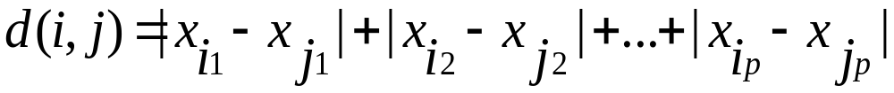
Similarity and Dissimilarity Between Objects
Distances are normally used to measure the similarity or dissimilarity between two data objects
Some popular ones include: Minkowski distance (general case)
  where i = (x_{i1}, x_{i2}, …, x_{ip}) and j = (x_{j1}, x_{j2}, …, x_{jp}) are two p-dimensional data objects, and q is a positive integer
If q = 1, d is Manhattan distance

Slide 9

Similarity and Dissimilarity Between Objects (Cont.)
If q = 2, d is Euclidean distance (most popular):
  Properties
    d(i,j) ≥ 0
    d(i,i) = 0
    d(i,j) = d(j,i)
    d(i,j) ≤ d(i,k) + d(k,j)
one can use weighted distance, parametric Pearson product moment correlation, or other disimilarity measures.

Slide 10
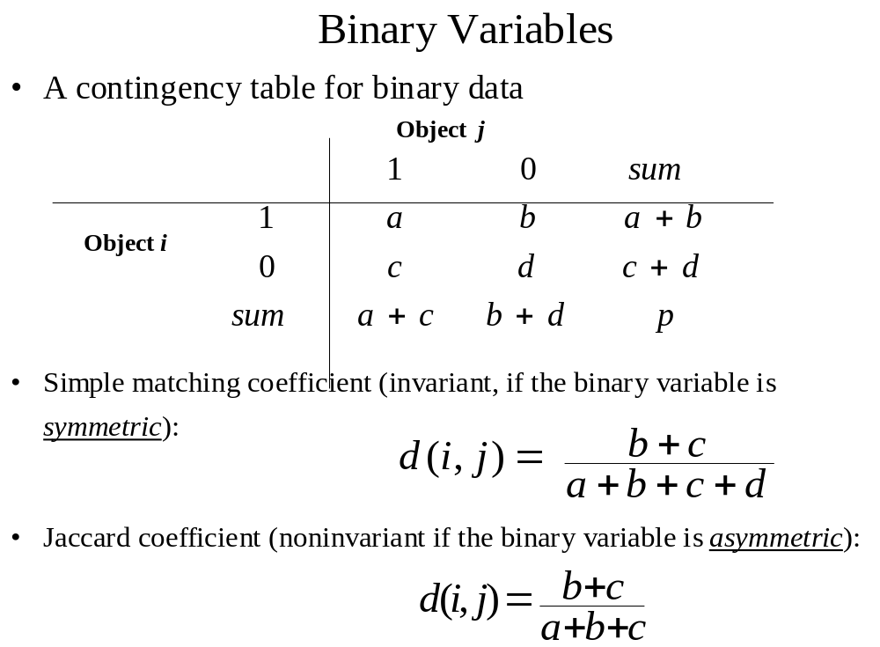

Slide 11


Dissimilarity between Binary Variables
Example
  gender is a symmetric attribute
  the remaining attributes are asymmetric binary
  let the values Y and P be set to 1, and the value N be set to 0

Slide 12
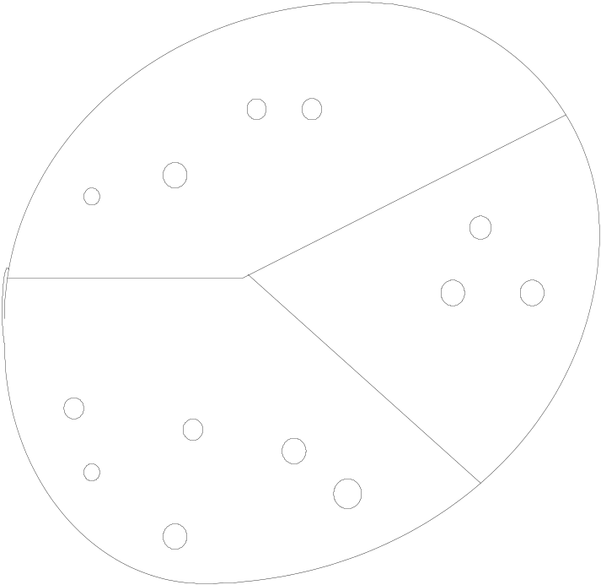
Partitioning Method
A partitioning method constructs k clusters. It classifies the data into k groups, which together satisfy the requirements of a partition.Each group must contain at least one object.
Each object must belong to exactly one group.
k <= n where k is the number of clusters with n objects.

Slide 13
Partitioning Algorithms: Basic Concept
Partitioning method: Construct a partition of a database D of n objects into a set of k clusters
Given a k, find a partition of k clusters that optimizes the chosen partitioning criterion
  Global optimal: exhaustively enumerate all partitions
  Heuristic methods: k-means algorithms
  k-means : Each cluster is represented by the center of the cluster

Slide 14
The K-Means Clustering Method
Given k, the k-means algorithm is implemented in 4 steps:
  Partition objects into k nonempty subsets
  Compute seed points as the centroids of the clusters of the current partition. The centroid is the center (mean point) of the cluster.
  Assign each object to the cluster with the nearest seed point.
  Go back to Step 2, stop when no more new assignment.

Slide 15
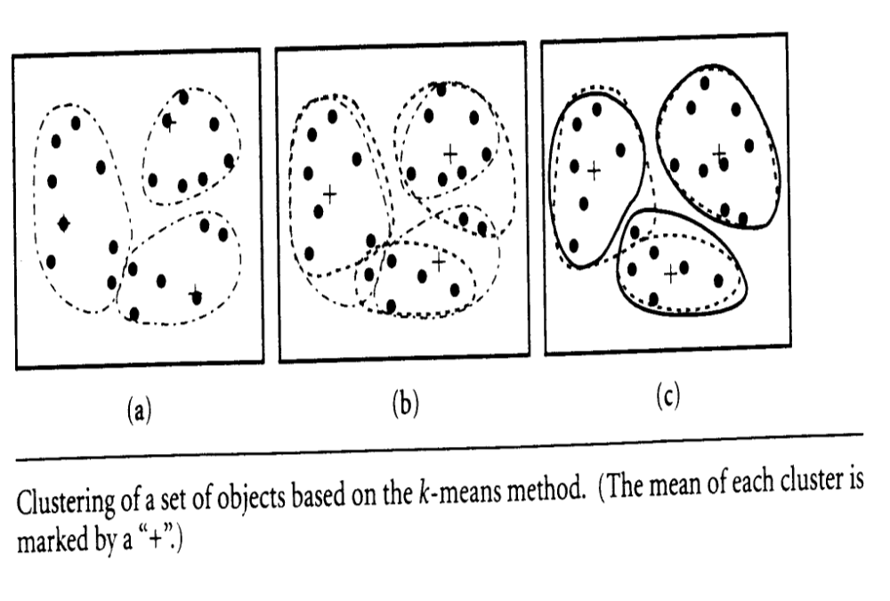
Clustering of a set of objects based on the k-means method

Slide 16

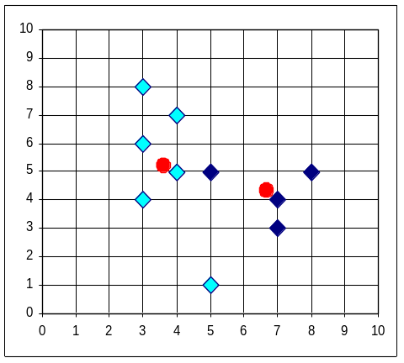


The K-Means Clustering Method
Example

Slide 17
Comments on the K-Means Method
Strength
  Relatively efficient: O(tkn), where n is # objects, k is # clusters, and t is # iterations. Normally, k, t << n.
  Often terminates at a local optimum. The global optimum may be found using techniques such as: deterministic annealing and genetic algorithms
Weakness
  Applicable only when mean is defined, then what about categorical data?
  Need to specify k, the number of clusters, in advance
  Unable to handle noisy data and outliers
  Not suitable to discover clusters with non-convex shapes

Slide 18
K-medoids algorithm
Arbitrarily choose k objects as the initial medoids;
Repeat
assign each remaining object to the cluster with the nearest medoid Oj;
randomly select a nonmedoid object, Orandom;
compute the total cost S of swapping Oj with Orandom;
if S < 0 then swap Oj with Orandom to form the new set of k medoids;
Until no change;

Slide 19
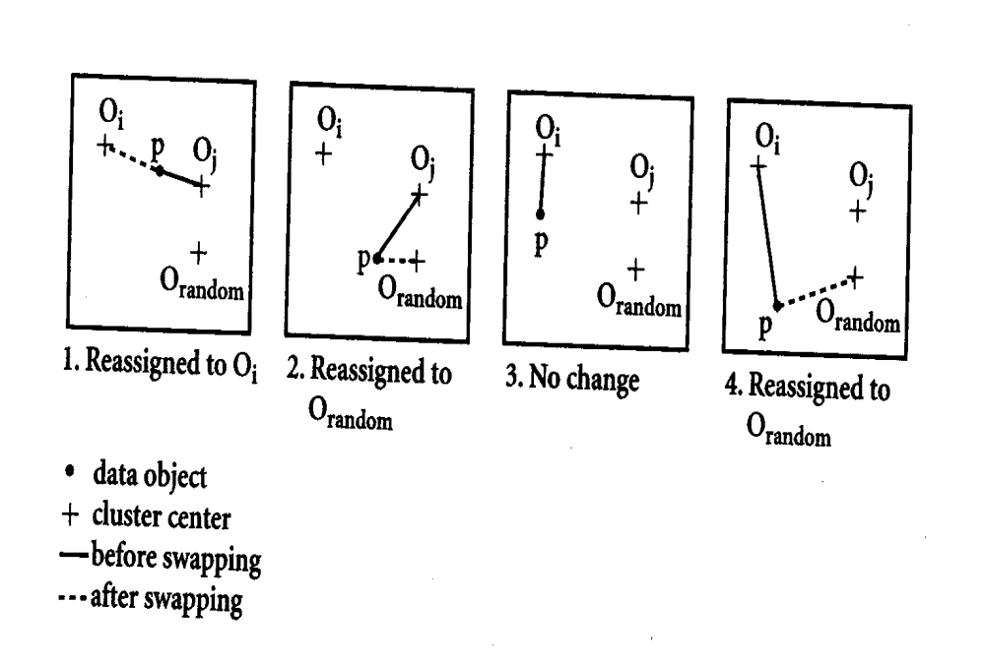
Four cases of the cost function for k-medoids clustering

Slide 20
Case 1: p currently belongs to medoid Oj. If Oj is replaced by Orandom as a medoid and p is closest to one of Oj; i not= j, then p is reassigned to Oi.
Case 2: p currently belongs to medoid Oj. If Oj is replaced by Orandom, then p is reassigned to Orandom.
Case 3: p currently belongs to medoid Oi, i not= j. If Oj is replaced by Orandom as a medoid and p is still closest to Oi, then the assignment does not change.
Case 4: p currently belongs to medoid Oi, i not= j. If Oj is replaced by Orandom as a medoid and p is closest to Orandom, then p is reassigned to Orandom.

Slide 21
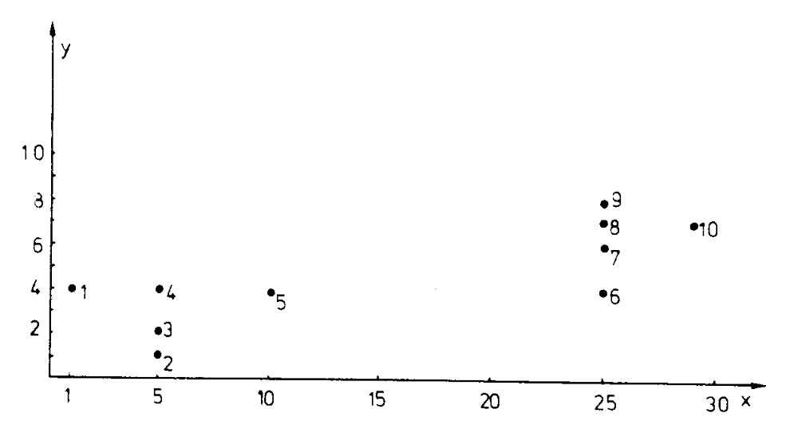
Two dimensional example with 10 objects

Slide 22
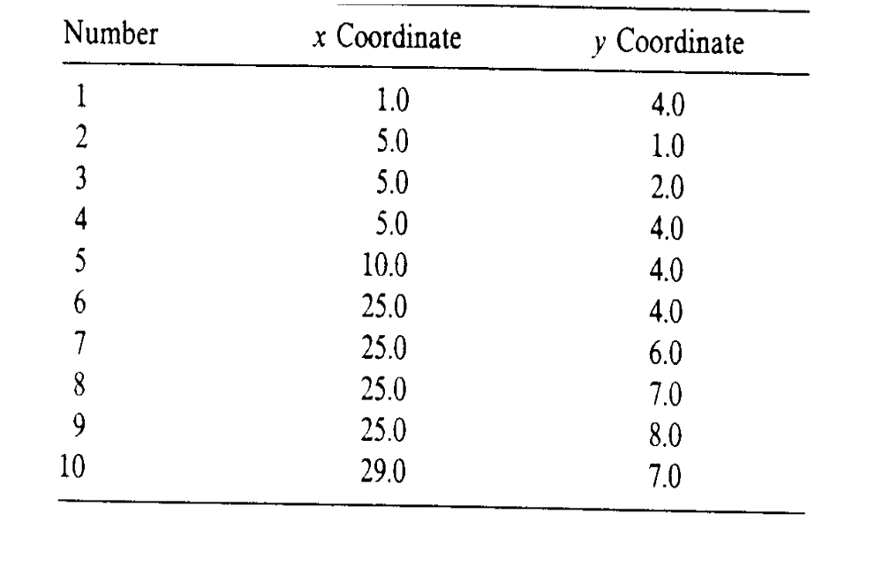
Coordinates of the 10 objects

Slide 23
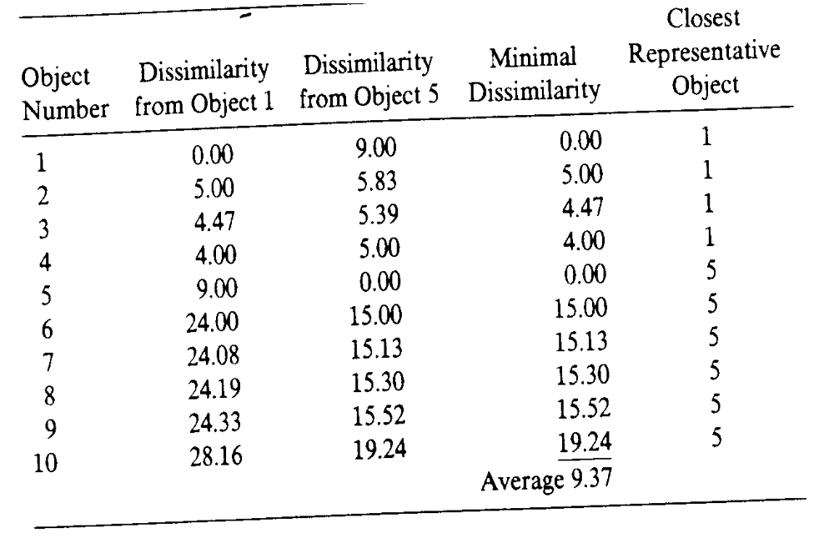
Assignment of objects to two representative objects

Slide 24
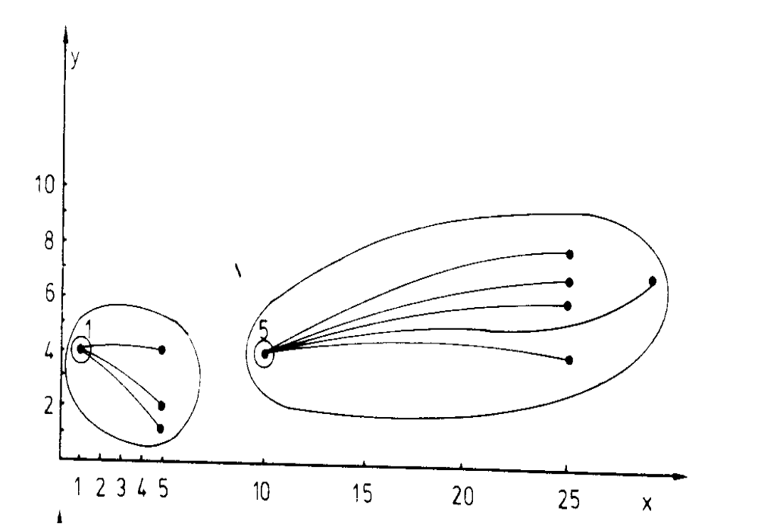
Clustering corresponding to selections of Number 1 and 5

Slide 25
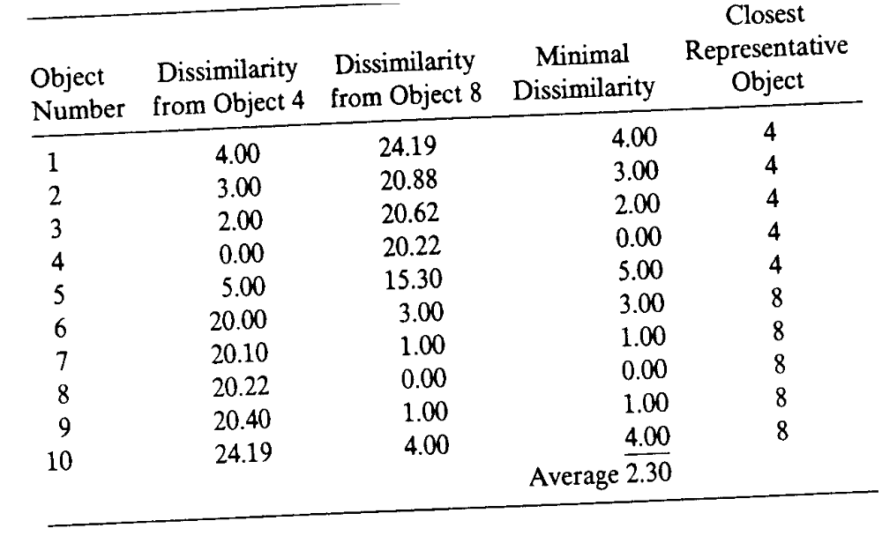
Assignment of objects to two other representative objects 4 and 8

Slide 26
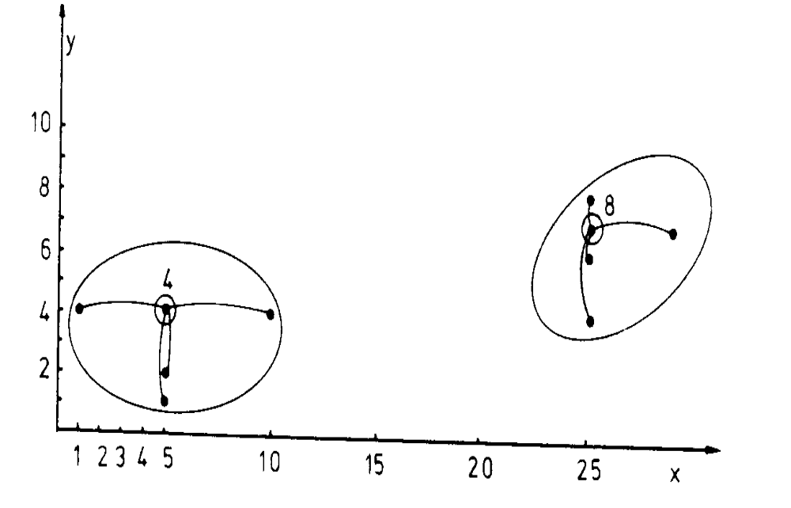
Clustering corresponding to selections of Number 4 and 8

Slide 27
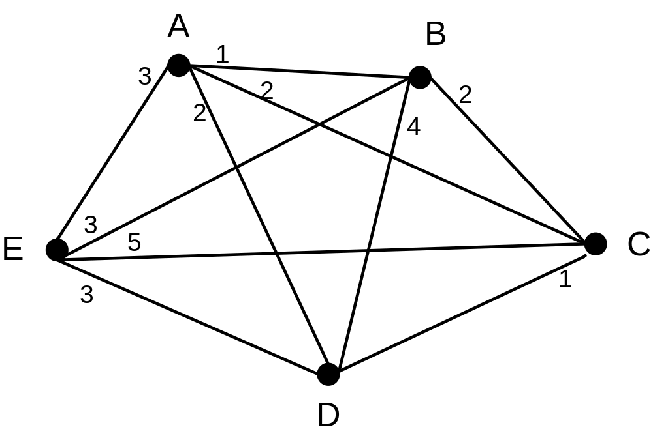
An example of clustering five sample data items graph with all distance

Slide 28
Sample table for the example
Item | A | B | C | D | E
A | 0 | 1 | 2 | 2 | 3
B | 1 | 0 | 2 | 4 | 3
C | 2 | 2 | 0 | 1 | 5
D | 2 | 4 | 1 | 0 | 3
E | 3 | 3 | 5 | 3 | 0

Slide 29
Example of K-medoids
Given the two medoids that are initially chosen are A and B. Based on the following table and randomly placing items when distances are identical to the two medoids, we obtain the clusters {A, C, D} and {B, E}. The three non-medoids {C, D, E} are examined to see which should be used to replace A or B. We have six costs to determine: TC_{AC} (the cost change by replacing medoid A with medoid C), TC_{AD}, TC_{AE}, TC_{BC}, TC_{BD} and TC_{BE}.
TC_{AC}=C_{AAC}+C_{BAC}+C_{CAC}+C_{DAC}+C_{EAC} = 1 + 0 – 2 – 1 + 0 = -2
Where C_{AAC} = the cost change of object A after replacing medoid A with medoid C

Slide 30
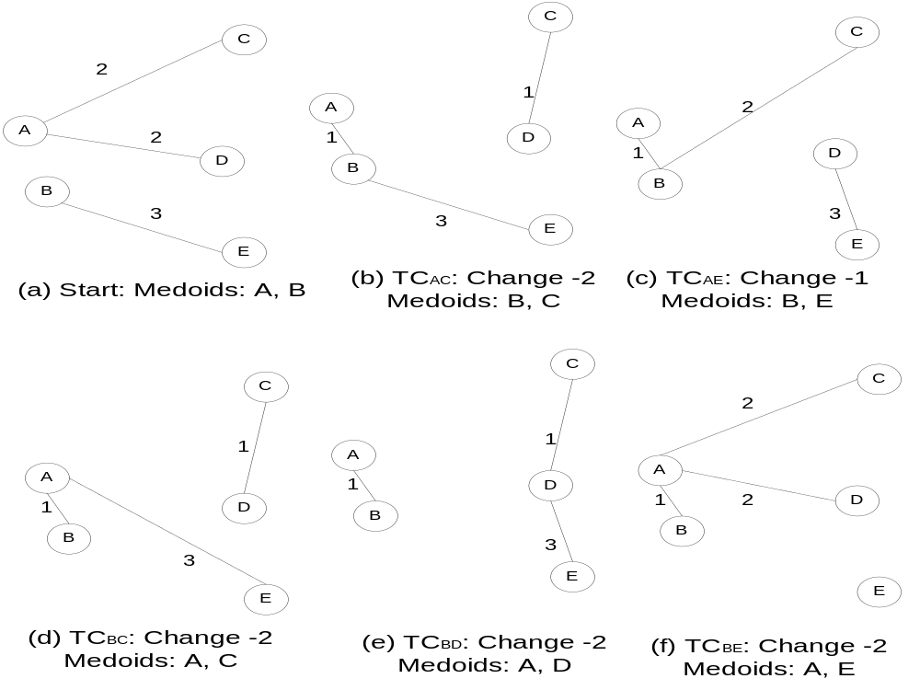

Slide 31
Cost calculations for example
The diagram illustrates the calculation of these six costs. We see that the minimum cost is 2 and that there are several ways to reduce this cost. Arbitrarily choosing the first swap, we get C and B as the new medoids with the clusters being {C, D} and {B, A, E}

Slide 32
An example
Initial five objects A, B, C, D, E, two clusters (A, C, D), (B, E), and centers {A, B}.
Evaluate swap enter A to center C.
Consider the new cost (new centers {B, C})
TC_{AC} = C_{AAC} + C_{BAC} + C_{CAC} + C_{DAC} + C_{EAC}
C_{AAC} = C_{AB} - C_{AA} = 1 – 0 = 1
C_{BAC} = C_{BB} - C_{BB} = 0 – 0 = 0
C_{CAC} = C_{CC} - C_{CA} = 0 – 2 = -2
C_{DAC} = C_{DC} - C_{DA} = 1 – 2 = -1
C_{EAC} = C_{EB} - C_{EB} = 3 – 3 = 0
As a result, TC_{AC} = 1 + 0 – 2 – 1 + 0 = – 2
The new center {B, C} is less costly. As a result, we should swan {A. B} to {B, C} by Medoid method

Slide 33
Comparison between K-means and K-medoids
The k-medoids method is more robust than k-means in the presence of noise and outliers because a medoid is less influenced by outliers or other extreme values than a mean. However, its processing is more costly than the k-means method. Both methods require the user to specify k, the number of clusters.

Slide 34
Case study of a behavioral segmentation for a phone company
This system is characterized by using large number of behavior related key drivers to cluster customer into different homogeneous segments, which are similar in term of profitability, call pattern or in other ways that are meaningful for marketing planning purposes. Our aim of the project is to develop a three dimensional segmentation according to customer revenue, call usage and call trend.

Slide 35
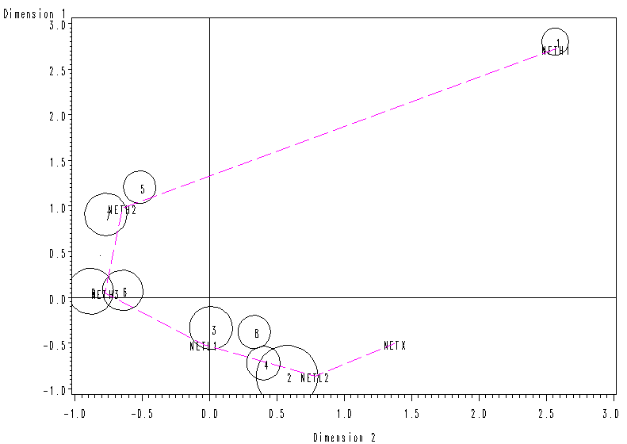
Sample report on clustering for a phone company to cluster customers based on the phone usages and revenue to the company
Call Revenue
Call Usage

Slide 36
Derived business rules (observation)
23% high profitable groups of customers in cluster #1, #5 and #7.
24% high usage caller group of customers in cluster #3, #8, #2 and #4.
Rule: High call usage implies higher call revenue,
but higher call revenue does not mean higher call usage.

Slide 37
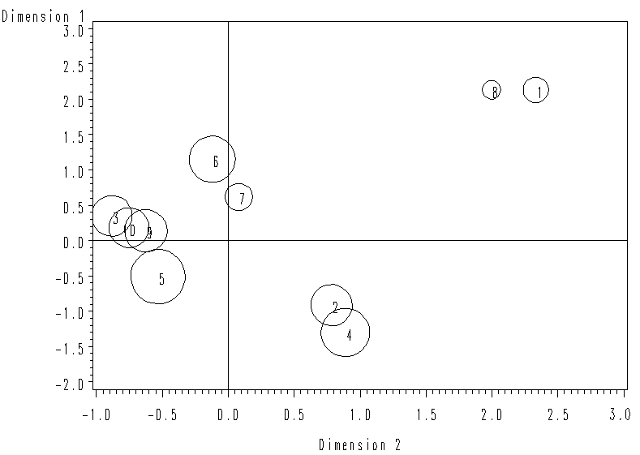
Sample report on clustering for a phone company to cluster customers based on the phone call duration and number of calls
Call Duration
Number of Calls

Slide 38
Derived business rules (observation)
High duration and High Calls in cluster #1, and #8.
Low duration and Low Calls in cluster #3, #5, #9 and #10.
Rule: High Duration calls most likely implies Higher Calls, while Low Duration calls most likely implies Lower Call.

Slide 39
Reading assignment
“Data Mining: Concepts and Techniques” 2nd Edition by Han and Kamber, Morgan Kaufmann publishers, 2007, chapter 7, pp. 383-407.

Slide 40
Lecture Review Question 9
What is supervised clustering and what is unsupervised clustering? How do you compare their difference with respect to performance? Illustrate the strength and weakness of k-means in comparison with the k-medoids algorithm.

Slide 41
Tutorial Question 9
The following table contains the attributes name, gender, trait-1, trait-2, trait-3 and trait-4, where name is an object-id, gender is a symmetric attribute, and the remaining trait attributes are asymmetric, describing personal traits of individuals who desire a penpal. Suppose that a service exists that attempts to find pairs of compatible penpals. For asymmetric attribute values, let the value P be set to 1 and the value N be set to 0. Suppose that the distance between objects (potential penals) is computed based only on the asymmetric variables.
Compute the Jaccard coefficient for each pair.
Who do you suggest would make the best pair of penpals? Which pair of individuals would be the least compatible?
Name | Gender | Trait-1 | Trait-2 | Trait-3 | Trait-4
Kevan | M | N | P | P | N
Caroline | F | N | P | P | P
Erik | M | P | N | N | P

